Slide 1
Microfinance and Social Business
------- Grameen Bank Experience.
Golam Morshed Mohammed
Deputy General Manager
Email:morshedgb64@gmail.com

Slide 2
Grameen Bank Project was born at the village Zobra1976
1976-1979 : Economic Research and Action project.
Project held under the Chittagong University.
1979-1983 : Pilot project.
Under the Central Bank of Bangladesh.
At the time part of other state owned commercial banks.
In October 1983, Grameen Bank was established as an independent financial institution through a special act passed by the parliament.

Slide 3
Where we are (September,2021)
# of Branches : 2568
# of Villages : 81676
# of Centres : 1452078
• # of Groups : 135417
# of Members : 10.22 million
Outstanding loan amount: 1535 million US$
Deposits amount: 2400 million US$
Rate of recovery: 97.25 %
Name: GRAMEEN BANK
Country: Bangladesh
Creation: 1976 (informal)1979 (pilot) & 1983(Formal)
Founder: Nobel Peace Laureate Prof. Muhammad Yunus
Deﬁnition: only collateral free bank in Bangladesh aiming to diﬀerentiate from the traditional banking methods by giving microcredit to its members -­‐ poor women from Bangladesh’ villages
Goals: eliminate exploitation of moneylenders; create self-­‐employment; break the vicious cycle of poverty; empower and unify scattered, marginalized and voiceless people; create good opportunities for the next generations

Slide 4
Grameen Bank Social Business
Addressing the poor
75% share own by borrowers. Remaining 25% own by Govt.
Sustainability
Income generating loan.
Housing Loan.
Profit distributed to the share holders borrowers .
Asset formation
Food, consumption & food security.
Higher Education Loan.
New Entrepreneurs loan
Microenterprise loan
Special Business loan (cow fatting)
Multy numbers of Savings Program.
Create Savings & household asset
Occupational Pattern change & employment
Change lifestyle (water, sanitation, education, jewelries and accessories.
There are 9 board members from borrowers shareholders.
They take part by significant rule at policy making platform.

Slide 5
Organogram
HEAD OFFICE
Zonal Office
Zonal Oﬃce (ZO)
8-12 AO at each ZO
Area Oﬃce (AO)
8-12 BO at each AO
Branch Oﬃce (BO)
60-80 centers at each BO
Center
6-10 groups
Group
Branch Office(BO)
Centre
Chairman
Secretary
Member
Member
Member

Slide 6
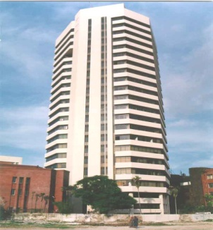
Monitoring flow
Group of 5 Members
Head Office
60-70 Centres per Branch
40 Zonal Office
Branch Office ( 2,568)
266 Area Office

Slide 7
Operational Procedure
1
2
3
4
5
6
7
Group Formation
Group Training
Group Recognition
Loan Proposal
Loan Disbursement
Loan Utilization
Loan Recovery

Slide 8
How does GB Microcredit Works
Initial Investment
Investment
Product
Sales
Profit
Reinvestment
Return of Initial Investment
Cycle of GB
Microcredit

Slide 9
Smart fund management
Loan for members
Member’s savings
Surplus send it to the H.Q
Non Member’s savings
Branch office

Slide 10
Grameen Bank’s loan offerings
1
Basic / Income - generating Loan
[20 % dicling method]
2
Housing Loan
[08 % dicling method]
]
3
Micro-enterprise Loan
[20 % dicling method]
]
4
Higher Education Loan
[0-5 % dicling method]
5
Struggling Member Loan
[0 % dicling method]
]
4
New Entrepreneur Loan
[ 20 % dicling method]
5
Special Loan
[ 20 % dicling method]
5
Seasonal Loan
[ 20 % dicling method]

Slide 11
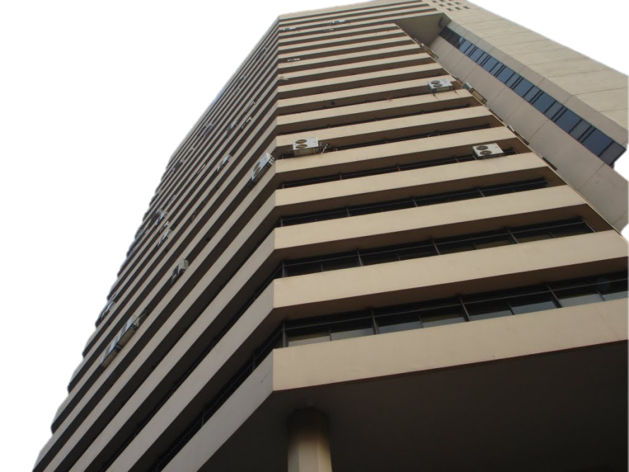
Basic Loan Major Categories

Slide 12
Quality Field duties helps to deduce delinquency
Visit 3 member’ houses per day
Talk with families and
Branch
Manager
neighbours
Surprise visits to centres
Visit
microenterprise loan businesses
Visit at least 1 centre per day
Guarantee credit discipline
Field Duties
Centre
Manager
Conduct 2 centre meetings per day
Monitor money utilization
Visit 2 member’ houses per day
Look for potential borrowers

Slide 13
Overdue loans
If the borrower doesn’t pay during 10 consecutive weeks
Duration < 1 year: if the total amount of the loan is not paid within the term
Duration = 1 year: if half of the loan is not paid within 6 months or 26 weeks
Duration > 1 year: if the total amount agreed for the first 6 months is not paid in this time
Loan full paid but interest unpaid more than 5 weeks
All loans under MEL, prescribe installments does not paid within 26 weeks
If the bridge loan (ceiling derives from savings) is not paid within the year
How loans become overdue…
Loan overdue?
Try to reach an agreement with the
borrower
Agreement?
Yes
Start the ﬂexible loan
Yes
No
Borrower pays?
Loan overdue – 1 year motivation
End
Yes
No
Loan written oﬀ

Slide 14
GB provisioning policy & default management
II
01%
Provisioning
Basic Loan
50% Provisioning
Detour
Flexi Loan
First detour
Second detour
Overdue
Exit from the
system
Re-entry into the system
100% Provisioning
Written off
One year
later:
written-off

Slide 15
Grameen Bank’s savings offerings
1
Personal Savings
5
Loan Insurance Savings
2
Fixed Deposit
6
Two Years Saving Deposit
3
Pension Scheme
7
Family Welfare Saving Deposit
4
Monthly Profit Deposit
8
Double in 9 Years

Slide 16
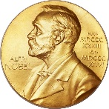
Awards and recognitions
ICMAB Best Corporate Award 2014
World Habitat Award 1997
MCCI Centenary award 2014
Tun Abdul Razak Award 1994
Nobel Peace Prize 2006
Indepedence Day Award 1994
Petersberg Prize 2006
King Badouin International Development Prize 1993
Gandhi Peace Prize 2000
Aga Khan Award for Architecture 1989

Slide 17
A Branch and staff is honored with a “Star” for the highest possible performance in a specific field.
GB Star achievement.
Area | Color | Star
100% repayment | Green
Earning profit | Blue
More deposit than loan outstanding | Violet
100% literacy | Brown
100% of borrowers over the poverty line | Red

Slide 18
disaster Management policies and practices.
Natural disaster and manmade disaster is one of the risks in the microfinance sector.
Grameen Bank have an efficient and effective disaster policy.
Grameen Bank has created disaster management fund called Rehabilitation Fund
Transfer of entire revenue profit from 1997-2005 in order to comply with the requirement for tax exemption allowed by the ministry of Finance.
Rehabilitation fund created 21.8 million BDT
Disaster Management:
Freezing loans, Transfer people at safe places, Provide food, Work Medical team, Vaccination for livestock, Workshop for psychological motivation

Slide 19
Special Programs of Grameen Bank
Loan Insurance Saving Fund (premium refundable)
At the death of the borrower or husband, entire outstanding amount of the loan is paid off.
Life Insurance Program (premium free)
International Scholarship International Scholarship
Scholarship Program
Scholarships are given 50% to girls, remaining to all.
Over 27,000 children received scholarship each year.
International Scholarship.
Ewha Women University (S.Korea), Khazanah Asia, (Malaysia), Glass glow Caledonian University (UK) and Asian University for Women(Bangladesh).
Nursing Education.
Each year 40 girls from Grameen borrowers family enrol at GCCN.

Slide 20
Social awareness and social audit program.
Eighteen decision.
Social awareness, motivational & development program. For socio economic development Grameen borrowers are following 18 Decisions.
12 Indicators (Social impact).
Grameen has an effective social audit system. It has developed 12 indicators to measure the impact of its operation.

Slide 21
Future plan of Grameen Bank.
Graduate Member and Second Generation Banking.
Create Young Entrepreneurs from the family.
Introduce Digital Banking.
Large Scale Investment.
Sustainable Development to the family.
Hygienic, Healthier and Happy family.

Slide 22
Future of Microfinance.
“Poverty will go to the museum”
Prof. Muhammad Yunus
Microcredit demand will continue until Zero Poverty. After that it will be shaped at new dimension. Financial need for human being will never end, when borrowers will be graduate, then they need upgrade microfinance.

Slide 23
Thanks All

