Slide 1
Micro-savings and Micro-investment in Agriculture: Experience of My House My Farm
Mihir Kanti Majumder, Ph.D.
Former Chairman, Palli Shanchay Bank

Slide 2
Bangladesh with Rich Natural Capital
Countries lying in between the Tropic of Cancer and Tropic of Capricorn are mega-biodiverse countries.
Entire water of Ganjes-Brammaputra-Meghna Basin (GBM Basin) flow to the Bay of Bengal through the rivers of Bangladesh.
Per capita fresh water availability in Bangladesh is 3 times more than the per capita world average.
Bangladesh is blessed with rich ecosystems and biodiversity.
Agriculture ecosystem, forest ecosystem, wetland ecosystem, coastal ecosystem, marine ecosystem, aquatics ecosystem, hill ecosystem, homestead ecosystem & other ecosystems are rich.

Slide 3
Bangladesh with Highest Population Density Per/sq km. Source: World Atlas/population information
Bangladesh: 1142
India: 360
Pakistan 215
Nepal: 212
China: 140
Iran : 50
USA: 32
Bhutan: 15
Russia: 08
Canada: 03.4
Australia: 03
Mongolia: 01

Slide 4
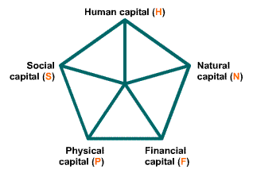
Capital Pentagon
Economic Capital: Movable and Immovable property.
Human Capital: Knowledge, Skill, Education, Health, Nutrition.
,
3. Social Capital: Cooperation, Collaboration, Morality, Self-esteem and the like
4. Natural Capital: Ecosystems, biodiversity, Minerals and the like.
5. Physical Capital: Infrastructure, Administration and Management System and the like.

Slide 5
Position of our Poor People in Capital Pentagon
Economic capital- Poor people have less financial assets.
Human capital- Poor people have insufficient human capital (Education, knowledge, skills).
Social capital- Poor people are very rich in social capital.
Natural capital- Poor people have less access.
Physical capital- Poor people have less access.

Slide 6
Traditional Family Farming
Bangladesh is blessed with a rich ecosystem. Therefore, traditional family farming has been developed here from time immemorial.
The productivity in the traditional family farming and formal agriculture was low because of inadequate skills as well as inappropriate technology.
Just after liberation in 1971, the poverty was about 80% as most of the people were engaged in agriculture sector having lower productivity.
Family farming became less attractive in comparison to growing industrial as well as service sector.

Slide 7
Micro-savings & its Practice
Developed since the development of agrarian society.
Traditional and Modern Practices:
Saving one fist of rice in earthen pots before cooking of meals daily.
Keeping coins/currency notes under the mattress or ground, in bamboo poles, earthen pot/wooden or steel box and in the loose end of a woman’s sari/dress.
Keeping small amount with trusted relatives and neighbors.
Purchase of cattle heads and taking lease of lands.
Deposit in formal Institutions like Cooperatives, Banks, Post office, Financial Institutions & Non-Govt. MFIs.
Mobile banking, agent banking, School Banking and other micro-savings scheme have replaced the traditional practices.

Slide 8
Hindrance of Micro-savings Practices
Poor people have less income and they can’t save because of spending all their earnings for Basic Minimum Needs.
Myths and Misperceptions to save money.
Male dominated income generating activities.
Loss of saved money by theft & diff. forms of deception.
Less education and awareness & less access to formal savings institutions.
Fear, intimidation & time cost relating to documentation for bank account.
Time cost and Money cost to deposit the savings.
Less interest rate to micro-savings & difficulties to withdraw the savings.
Lack of attractive micro-savings scheme in the past.

Slide 9
Concept of Amar Bari Amar Khamar (My House My Farm)
Developed by Hon’ble Prime Minister Sheikh Hasina to:
Promote Microsavings practices.
Develop skills of Rural population in Agro-based livelihoods.
Promote homestead faming with increased productivity for poverty alleviation.
Provide low-cost seasonal credit.
Promote micro-entrepreneurs.
Provide digital financial services to save time cost, money cost and other associated costs.

Slide 10
Microsavings in My House My Farm
Micro-savings is the small savings of the past and non-liable investment in the future.
Microcredit & Micro-savings are the two sides of a coin and complementary to each other.
Micro-savings help create a financial buffer that reduces the economic vitality of the poor.
Development of industrial and service sectors, demographic bonus, decrease of family size & increase of employment opportunities have increased micro-savings opportunities.
Incentives has been introduced to promote micro-savings among the marginalized group members to improve their savings practices.

Slide 11
My House My Farm & Capital Pentagon
Economic Capital: Incentives to increase Micro-savings Practice and low-cost seasonal credit.
Human Capital: Development of Skilled Volunteers on Poultry, Fishery, Cattle rearing, Horticulture, Vermicompost, Homestead agriculture & Health at the society level.
Social Capital: Development of organized community groups in the form of Societies.
Natural Capital: Increase access of the community groups towards natural capital.
Physical Capital: Initiatives to increase the access of the community groups towards physical capital.

Slide 12
My House My Farm Project Activities
Formation of legalized village organizations.
Development of village volunteers in five fields (poultry, fishery, livestock, homestead agriculture, forest nursery and horticulture) in each org. to promote and disseminate related knowledge & skills.
Incentives for promoting commitment for micro savings. Savings= (Income –Exp.) x Commitment.
Seasonal as well as low cost credit to promote more investment in agriculture sector at micro level.
Promote processing of agriculture produce and facilitate marketing to ensure better price.
Promote and popularize digital financial services.
Develop each homestead as a modern agriculture farm with increased productivity.

Slide 13
Initiatives for Promotion of Micro-savings
Year | Nature of Savings | Savings of individual Member | Equal amount of Incentives to individual Member | Revolving Fund to society (maximum 60 members)
Year-1 | Voluntary Microsavings | Tk=200 Per Month (maximum) | Tk=200 Per Month (maximum) | Tk=200/-Member/Per Month
Year-2 | Voluntary Microsavings | Tk=200 Per Month | Tk=200 Per Month | Tk=200 Member/Per Month
Year-3 | Mandatory microsavings | Minimum Tk=60 Per Month (BDT=2/day) | - | -
Year-4 | Mandatory microsavings | Minimum Tk=60 Per Month (TK=2/day) | - | -
Year-N | Mandatory microsavings | Minimum Tk=60 Per Month (TK=2/day) | - | -

Slide 14
Micro-investment in My House My Farm Project
SL. No | Nature of Farm |  | Percentage
1 | Livestock |  | 28.82
2 | Poultry |  | 20.25
3 | Fishery |  | 11.18
4 | Vegetable garden |  | 06.02
5 | Plant nursery |  | 05.55
6 | Others including agro-based processing as well as business activities |  | 28.18

Slide 15
Institutionalization of the Project
The project ended on June, 2020. The concept & activities needed institutionalization to sustain & continue the program.
Government established Palli Sanchay Bank through enactment of Law in 2014.
Share of the Bank: Govt.-51%, Members-49%.
485 branches have been opened with Core on line Banking Service (one branch in each Sub-district).
Around 121000 community groups developed covering 5.68 million marginalized families (one member in each family).
The groups with accumulated fund of Tk. 70.38 Trillion have been transferred to Palli Sanchay Bank.

Slide 16
Poverty alleviation & Middle class Groups in Bangladesh
Poverty has come down from around 80% in 1972 to 20.5% in 2020 in Bangladesh.
The poverty-graduates are joining the lower-middle class and middle class group.
Every year around 2 million marginalized and poor people are joining this groups.
These groups holds the characteristics to make savings, become entrepreneurs and invest more for consumption which facilitates industrialization.

Slide 17
Middle Class to entrepreneurs
The improved savings practice of this middle class groups form group capital.
Their increased consumption behavior facilitates industrialization.
Low-cost SME credit facilitates to develop them as micro-entrepreneurs and creates employment opportunities.
Considering those positive characteristics of middle class group, My House My Farm project took initiatives to develop the group members as entrepreneurs.

Slide 18
Ecosystem and Rural Livelihoods
Ecosystem includes plants, animals, micro-organisms, soil, rocks, minerals, water sources & the atmosphere interacting with one another.
Ecosystem & Environment depend on the balance of three kinds of Lives:
They are Producer (all kinds of plants), Consumer (human being, fish, birds, animals, insects etc.) and Reducer (micro-organisms).
More dependence of rural population on ecosystems and its services and over exploitation of ecosystem goods affect this balance seriously and reduce productivity.
The project conducted ecosystem-based livelihood activities to promote ecosystems as well as livelihoods with increased productivity.

Slide 19
Ecosystem Conservation Through Payment for Ecosystem Services (PES) & Livelihoods Promotion
Agriculture, fishery, livestock, poultry & other agriculture-based production depend on ecosystem.
PES is a highly promising conservation approach that benefits all stake holders & improves the ecosystem.
Manage ecosystems through economic incentives & ensure community participation.
Pro-poor PES ensures participation of community people, generates employment, improves ecosystems, promotes ecological services & contributes to poverty alleviation
My house My Farm project developed more than 3000 ecosystem-based societies to conserve ecosystems, promote livelihood and improve productivity.

Slide 20
Pro-poor PES in Madhupur Forest
Madhupur soil has been developed in 900,000 years.
Madhupur Shal forest (40,000 acres) is about 2200 years old.
Surrounding 57 village hold 40,000 population.
More than 700 tree cutters depleted forest in recent years
(640,000 trees per year).
Those 700 tree cutters are now community forest workers having alternative livelihoods organized in 12 cooperatives.
IG Activities: Cattle rearing, alternative livelihood support, homestead farming, tree plantation, forest protection .
Re-vegetation started with wild life & no record of forest depletion.

Slide 21
Digital Financial Service: Palli Len-den

Slide 22
Poultry Farming by Liton Mia at Gazipur

Slide 23
Cattle Rearing

Slide 24
Fish Hatchery of Yeasmin Jahan at Joypurhat

Slide 25
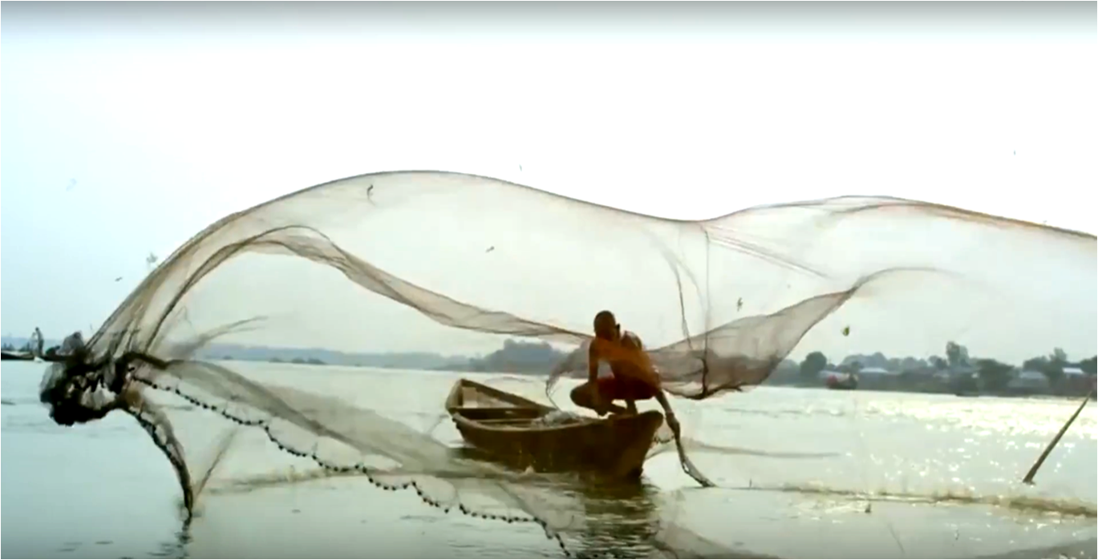
Thank You

